Slide 1
Predicting False information about Crime using Supervised Machine Learning
By : Anusha Ayyagari
Harikrishna Bhumani

Slide 2
Introduction:
Fake news can be defined as a set of elaborate lies or hoaxes that are deliberately fabricated to mislead or defame an individual, a community or an organization.
With the widespread reliance on social media for information and unchecked growth of such platforms, false news reaches millions of people in a matter of few seconds.
In recent years Fake news has led to several civic unrests, healthcare threats to national security, Cyberbullying, public shaming, mental health crisis and in extreme cases wrongful convictions.
Given this dangerous nature of false information it necessary to identify this information and remove it from social media platforms as soon as possible.

Slide 3
Objective and Research questions:
Our research tries to answer the below questions:
Can we determine if the given information about crime is true or false?
Are the platforms where the statements were made and the labels dependent ?
Are the sources of information and labels dependent?
Are the negative sentiment and the label dependent?
What is the average time required to check if the statement is true or false manually?
Does machine learning algorithms perform better than deep learning algorithms for predicting the class of the statement

Slide 4
Dataset:
PolitiFact.com is an American nonprofit project operated by the Poynter Institute in St. Petersburg, Florida.
It is a reliable source of information as the statements are manually evaluated by the journalists and assign ratings which range from "True" for statements the journalists deem as accurate to "Pants on Fire" if journalists deem the post as "not accurate and makes a ridiculous claim".
We are scraping the data from the website in the categories of crime,guns and marijiuna.

Slide 5
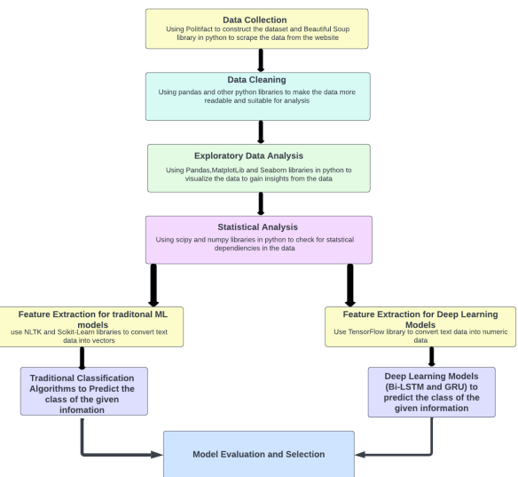
Proposed Model Architecture
Figure 1 Proposed Model Architecture.
Source: (Ayyagari & Bhumani,2022)

Slide 6
Overview:
Data Collection: We extract labeled data from the section’s of crime, guns, and marijuana of the PolitiFact website.
Data Cleaning: We clean the data so that we can derive insights from it and then convert it into a format suitable for classification algorithms.
Exploratory Data Analysis (EDA): We use statistics and visualizations to analyze and identify trends in data set.
Statistical Analysis: We use in-built python libraries to perform Hypothesis testing and derive insights from the data
Feature extraction: We make use of various natural language processing methodologies to transform the text data into data suitable for machine learning models to process.
Prediction: We build and evaluate various traditional machine learning algorithms as well as a few deep learning algorithms to classify if the given statement is true information or not. The best model is selected and deployed for further use.

Slide 7
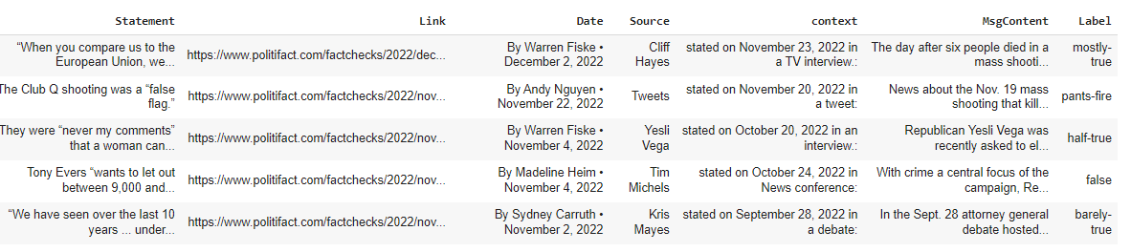
Data Before cleaning:
Figure 2: Data Before Cleaning
Source: (Ayyagari & Bhumani,2022)

Slide 8
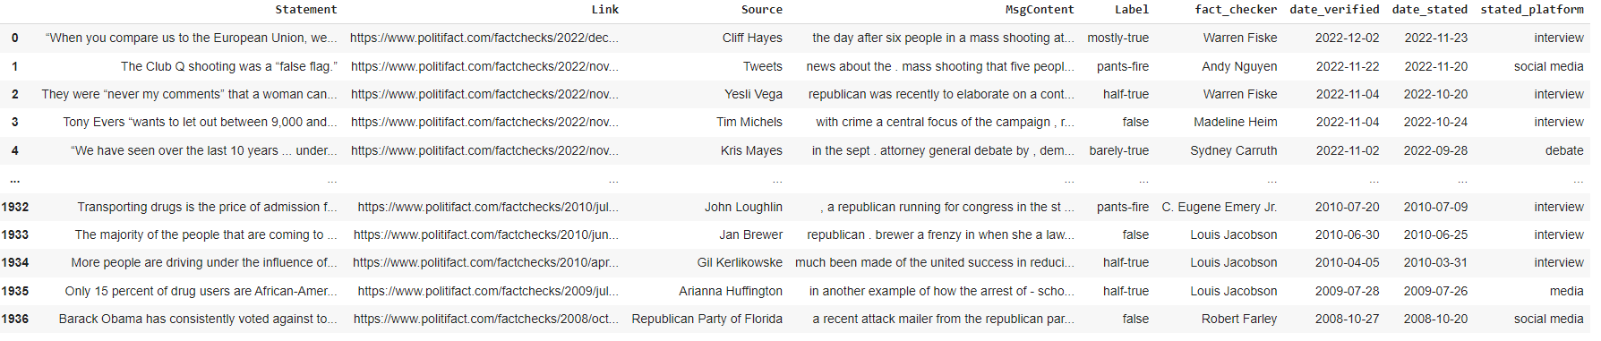
Final data frame
Figure 3: Final Dataframe
Source: (Ayyagari & Bhumani,2022)

Slide 9
EDA
For EDA we are making the below transformations:
Use the VADER library to get the sentiment for the statements to see if sentiments affect the labels.
The labels 'barely-true','pants-fire' and 'false' labels are converted to false and 'half-true',’mostly-true’ and ‘true’ are converted to True to build a model.

Slide 10
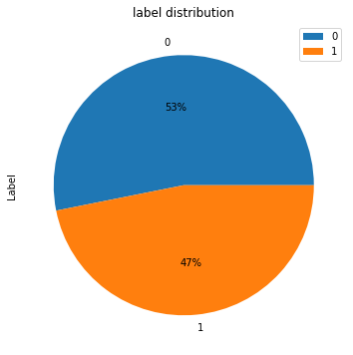
Label distribution:
Figure 4: Label Distribution
Source: (Ayyagari & Bhumani,2022)

Slide 11
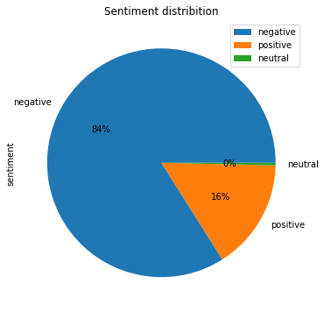
Sentiment distribution:
Figure 5: Sentiment Distribution
Source: (Ayyagari & Bhumani,2022)

Slide 12
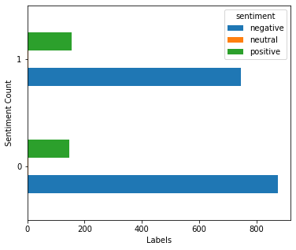
Sentiment Label Count:
Figure 6: Sentiment Label Count
Source: (Ayyagari & Bhumani,2022)

Slide 13
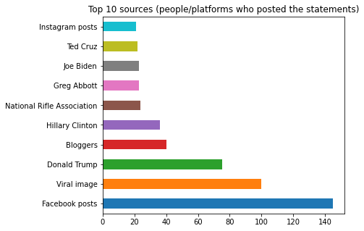
Top 10 information sources:
Figure 7: Top 10 Information Sources
Source: (Ayyagari & Bhumani,2022)

Slide 14
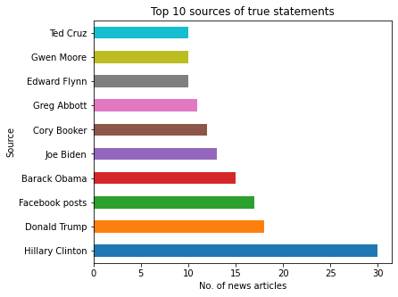
Top 10 sources of true information (people/platforms who posted the statements)
Figure 8: Top 10 Sources of True information
Source: (Ayyagari & Bhumani,2022)

Slide 15
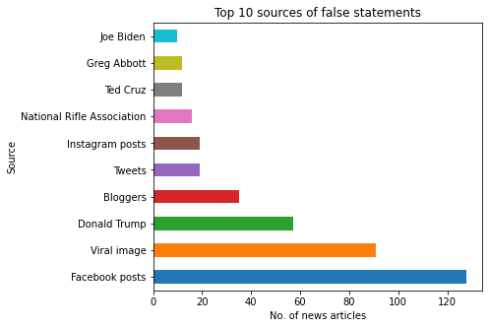
Top 10 sources of misinformation:
Figure 9: Top 10 Sources of misinformation
Source: (Ayyagari & Bhumani,2022)

Slide 16
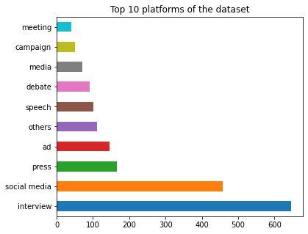
Top 10 platforms of the dataset
Figure 10: Top 10 platforms of the dataset
Source: (Ayyagari & Bhumani,2022)

Slide 17
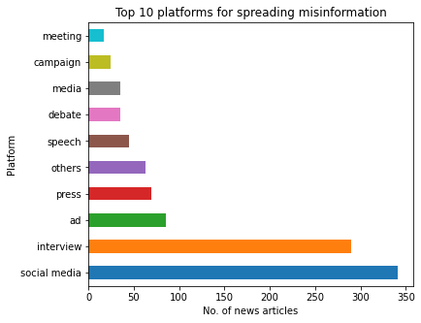
Top 10 platforms for spreading misinformation
Figure 11: Top 10 platforms for spreading misinformation
Source: (Ayyagari & Bhumani,2022)

Slide 18
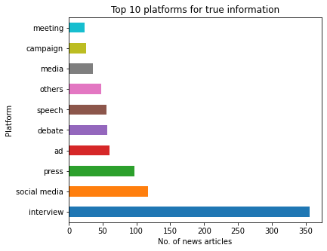
Top 10 platforms for true information
Figure 12: Top 10 platforms for True information
Source: (Ayyagari & Bhumani,2022)

Slide 19
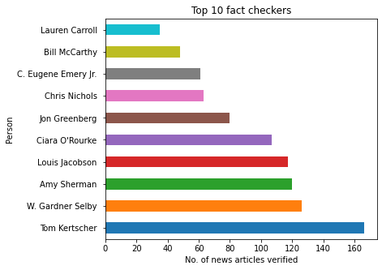
Top 10 fact checkers
Figure 12: Top 10 fact checkers
Source: (Ayyagari & Bhumani,2022)

Slide 20
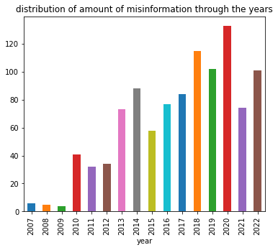
Amount of misinformation through the years
Figure 13: Amount of misinformation over the years
Source: (Ayyagari & Bhumani,2022)

Slide 21
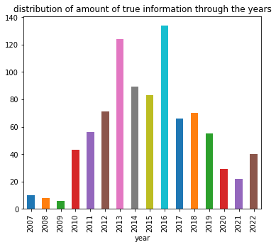
Distribution of true information throughout the years:
Figure 14: Distribution of True information through the years
Source: (Ayyagari & Bhumani,2022)

Slide 22

Statistical Analysis:
To check the dependency between the source and the label.
Null Hypothesis: source and the labels are independent
Alternative hypothesis: source and the labels are dependent
Result: p<0.05, hence we reject the null hypothesis.Source and the labels are dependent

Slide 23

cont..
2. To check the dependency between the platform and the label.
Null Hypothesis: The Label and platform where the information was posted are independent.
Alternate Hypothesis: The Label and platform where the information was posted are dependent.
Result: p<0.05, hence we reject the null hypothesis.Platform where the information was posted and the labels are dependent

Slide 24

cont..
3. To check the dependency between the negative sentiment and the label.
Null Hypothesis: The Label and negative sentiment are independent.
Alternate Hypothesis: The Label and negative sentiment are dependent.
Result: p>0.05, hence we fail to reject the null hypothesis.The label and the negative sentiment are independent

Slide 25
cntd
Average time required over the years to fact check the information: 17.4 days
Average time required over the years to check if the statement is True: 16.73 days
Average time required over the years to check if the statement is false: 17.99 days

Slide 26
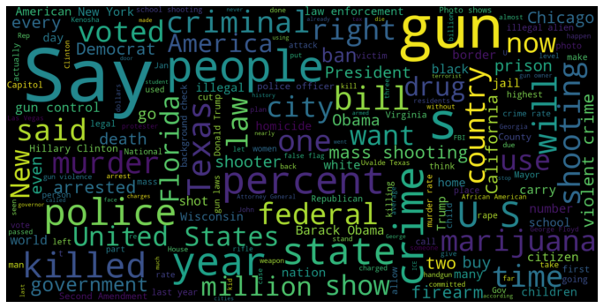
Most Frequent words associated with false label
Figure 15: Most Frequent words of false label
Source: (Ayyagari & Bhumani,2022)

Slide 27
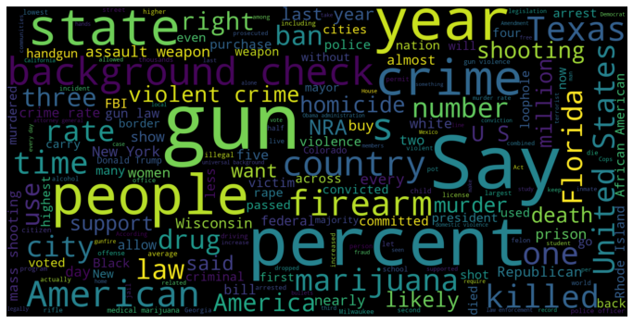
Most Frequent words associated with True label:
Figure 16: Most Frequent words of True label
Source: (Ayyagari & Bhumani,2022)

Slide 28
Feature extraction for Traditional ML models
Remove any alphanumeric and numeric characters from the text.
We are creating variable model_training_dataset to store the information about the MsgContent and model_testing to store the labels.
Splitting the data into training and test datasets.
Using CountVectorizer to transform a given text into a vector on the basis of the frequency (count) of each word that occurs in the entire text.
We use TfidfTransformer to transform text into a meaningful representation of numbers which is used to fit machine algorithm for prediction.

Slide 29
Feature extraction for Deep Learning models
We create two variables X and y that store the content and the target variables and split the dataset into training and test datasets.
we use the ‘Tokenizer’ from TensorFlow to split the texts into tokens or words while keeping only the most occurring words in the text corpus. The num_words parameter keeps a prespecified number(in this case 5000 words) of words in the text only.
We then pad the sentences using ‘pad_sequences’ function as the model expects that each sequence(each training example) will be of the same length(same number of words/tokens).
We convert the labels to categorical values (one hot vector encoding).

Slide 30
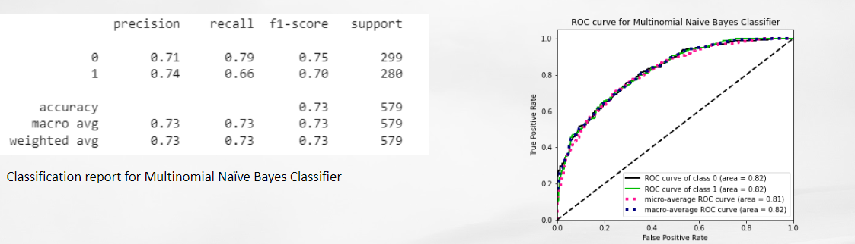
Naive Bayes Classification Model:
Figure 17: Naive Bayes model classification report
Source: (Ayyagari & Bhumani,2022)

Slide 31
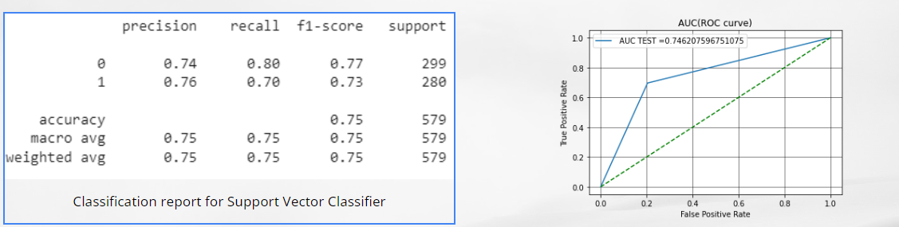
SVM with grid search:
Figure 18: SVM with GridSearchCV
Source: (Ayyagari & Bhumani,2022)

Slide 32
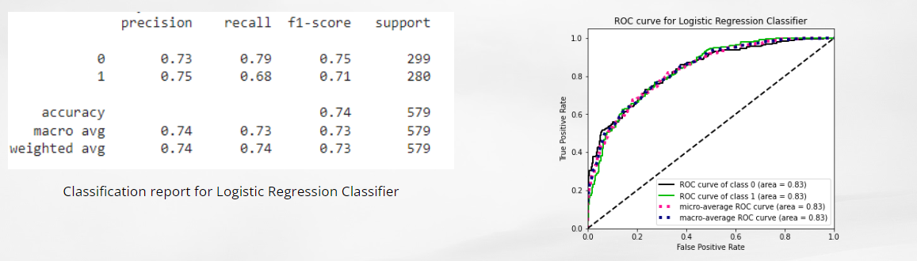
Logistic Regression:
Figure 19: a) Logistic Regression Classification report
b) ROC Curve
Source: (Ayyagari & Bhumani,2022)

Slide 33
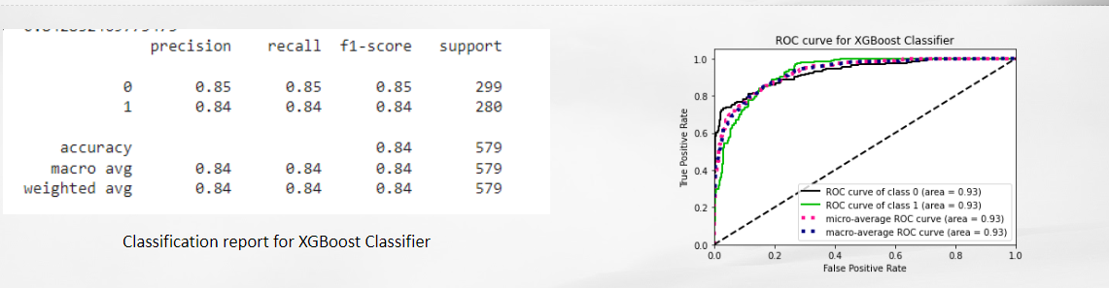
XGBoost(with grid search)
Figure 20: XGBoost Model with GridSearchCV
Source: (Ayyagari & Bhumani,2022)

Slide 34
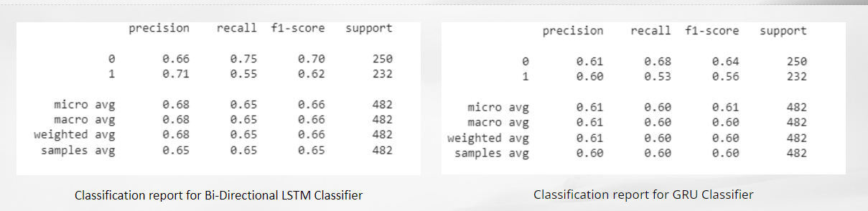
Deep Learning Models
Figure 21: a) Bi-LSTM Model Classification Report
b) GRU Model Classification Report
Source: (Ayyagari & Bhumani,2022)

Slide 35
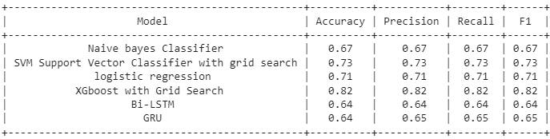
Model Results:
Figure 9: Model Results
Source: (Ayyagari & Bhumani,2022)

Slide 36
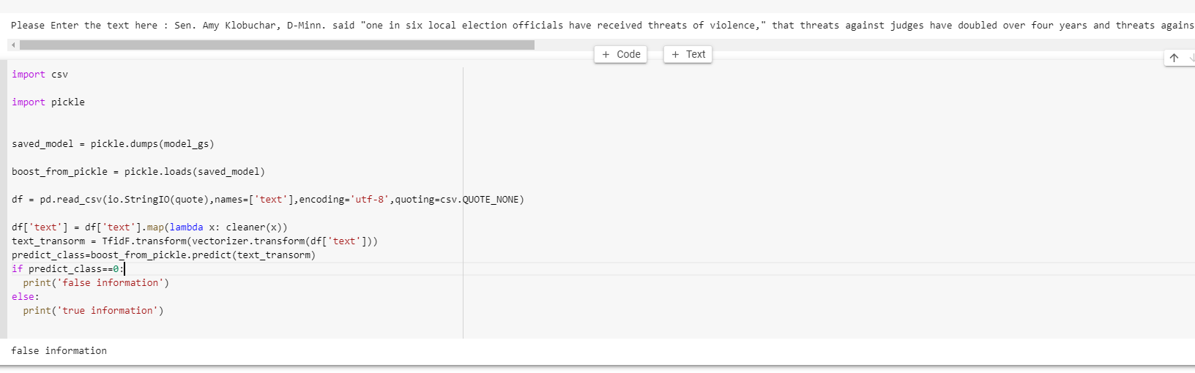
Model Deployment:

Slide 37
Answers to research questions:
Can we determine if the given information about crime is true or false?
Ans: Yes, we were able to determine the label with an accuracy of 82%
Are the platforms where the statements were made and the labels dependent ?
Ans: Yes, they are dependent
Are the sources of information and labels dependent?
Ans: Yes, they are dependent
Are the negative sentiment and the label dependent?
Ans: No, they are independent
What is the average time required to check if the statement is true or false manually?
Ans: 17.4 days
Does traditional machine learning algorithms perform better than deep learning algorithms for predicting the class of the statement?
And: Yes, traditional machine learning algorithms perform better

Slide 38
Future Scope:
The model can be integrated with any social media platform or an independent website to validate the information posted about crime.
The results of the model can be used to FLAG any false information and inform the users about the nature of the information.
The model can be trained on larger datasets to expand its scope beyond crime and can identify any false information.
The dataset constructed for training and testing the model can be used by others to build their own model.
Attention mechanisms and word embeddings can be used to further increase the accuracy of the model.

Slide 39
Limitations:
Increasing the size of the dataset will increase the accuracy of deep learning models.
Loss of information when converting from multi class classification problem to binary classification problem
Models trained only on Crime Specific datasets
Requires More Sophisticated Pre-Processing Algorithms

Slide 40
Conclusion:
Built the dataset from scratch using a reliable datasource
Used Sentiment analysis to check if the sentiment affects the classification of the information.
Used different classification algorithms to predict if the given information is true or false.
The XGBoost classifier has an accuracy of 82% and was selected as final model
As per our dataset an average of 17.4 days are required to assign a label to the information, while our model takes a few seconds to read the information, perform feature extraction and predict the appropriate label.
Our model can be integrated by any social media platform to either flag the post or take it down, thereby slowing the spread of misinformation.

Slide 41
Individual Contributions:
Anusha Ayyagari:
Project selection
Defining problem statement
Selecting the appropriate dataset for the project.
Coding for Exploratory data analysis, Statistical Analysis, Feature extraction and model development sections.
Code review
Authored sections Literature review,Methodology,Data Analysis and Model Design actions of the paper “Predicting False information About Crime Using Supervised Machine Learning”
Co-developer for the project website
Co-author for the project presentation
Model evaluation and saving the model.

Slide 42
Harikrishna Bhumani:
Project selection
Formulating research questions
Refining the dataset to include more content
Coding for data collection,Data Cleaning, Feature extraction and code enhancements.
Authored introduction, dataset and limitations and future scope.
Final paper alignment and format.
Co-developer of the website and presentation.
Created the GitHub repository for the project.

Slide 43

Q&A

Slide 44
References:
Anusha Ayyagari and Harikrishna Bhumani.(2022). Predicting false information about Crime using Supervised Learning.
https://www.politifact.com/crime/
B. N. A. S. a. M. R. Z Khanam, "Fake News Detection Using Machine Learning," IOP Conference Series: Materials Science and Engineering, 2020.
S. Pappas, "Fighting fake news in the classroom," Monitor on Psychology, p. 53, 2022.
W. Y. Wang, "Liar, Liar Pants on Fire: A New Benchmark Dataset for Fake News Detection," Proceedings of the 55th Annual Meeting of the Association for Computational Linguistics (Volume 2: Short Papers), 2017
K. a. M. D. a. W. S. a. L. D. a. L. H. Shu, "FakeNewsNet: A Data Repository with News Content, Social Context and Spatialtemporal Information for Studying Fake News on Social Media," arXiv, 2018.

Slide 45


